Slide 1
Cortex-M3 Exceptions and Interrupts

Slide 2
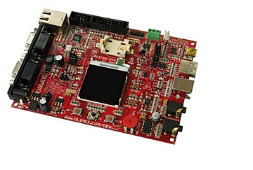
Chapter 7, 8, 9 in the reference book

Slide 3
9.1 Exceptions
9.1.1 Exception Types
Exceptions are numbered 1 to 15 for system exceptions and the rest 240 for external interrupt inputs.(Total 256 entries in vector table.)
Most of the exceptions have programmable priority, and a few have fixed priority.
The value of the current running exception is indicated by the special register IPSR or from the NVIC’s Interrupt Control State Register.

Slide 4
List of Exceptions
Exception Number | Exception Type | Priority | Description
1 | Reset | -3 (Highest) | Reset
2 | NMI | 2 | Nonmaskable interrupt (external NMI input)
3 | Hard Fault | -1 | All fault conditions, if the corresponding fault handler is not enabled
4 | MemManage Fault | Programmable | Memory management fault; MPU violation or access to illegal locations
5 | Bus Fault | Programmable | Bus error, like Prefetch abort
6 | Usage Fault | Programmable | Exceptions due to program error or trying to access coprocessor
7-10 | Reserved | N/A | —
11 | SVCall | Programmable | System Service call
12 | Debug Monitor | Programmable | Debug monitor

Slide 5
(Continued)
13 | Reserved | N/A | —
14 | PendSV | Programmable | Pendable request for system device
15 | SYSTICK | Programmable | System Tick Timer
16 | External Interrupt #0 | Programmable | External Interrupt
17 | External Interrupt #1 | Programmable | External Interrupt
… | … | … | …
255 | External Interrupt #239 | Programmable | External Interrupt

Slide 6
9.1.2 Definitions of Priority
Priority of the exception:
A higher-priority exception can preempt (抢占) a lower-priority exception.
Reset, NMI, and hard fault have fixed priority levels
The Cortex-M3 supports 256 levels of programmable priority.
The reduction of priority levels can be implemented by cutting out several lowest bits of the priority configuration register.

Slide 7

3 bits of priority level
Bit 7 | Bit 6 | Bit 5 | Bit 4 | Bit 3 | Bit 2 | Bit 1 | Bit 0
Implemented |  |  | Not implemented, read as zero
4 bits of priority level
Bit 7 | Bit 6 | Bit 5 | Bit 4 | Bit 3 | Bit 2 | Bit 1 | Bit 0
Implemented |  |  |  | Not implemented, read as zero
The minimum number of implemented priority register widths is 3 bits.

Slide 8
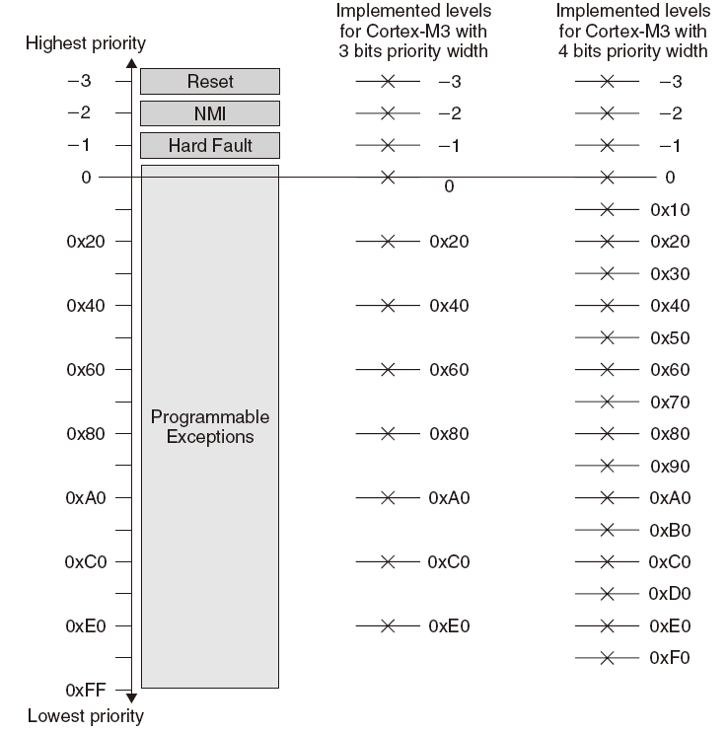
Available Priority Levels with 3-Bit or 4-Bit Priority Width

Slide 9
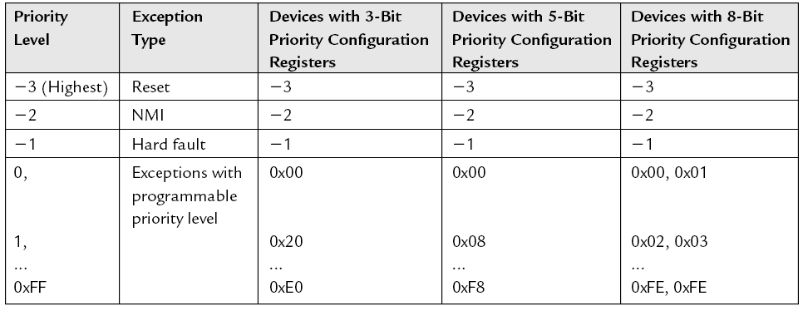
Examples of available exception priority levels for devices with 3-bit, 5-bit, and 8-bit priority registers:
Available Priority Levels for Devices with 3-bit, 5-bit, and 8-bit Priority Level Registers

Slide 10
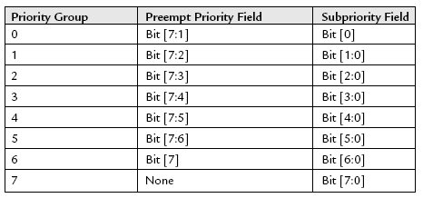
This register is further divided into two parts: preempt priority and subpriority.
Using a Priority Group register, the priority-level configuration register can be divided into two halves, i.e., the upper half (preempt priority ) and the lower half (subpriority).
Preempt priority: an interrupt or exception with a higher preempt priority can preempt one with a lower preempt priority
Subpriority: the order when multiple interrupts or exceptions with the same preempt priority occur at the same time

Slide 11
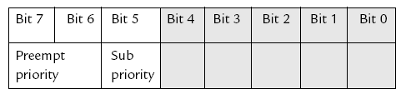
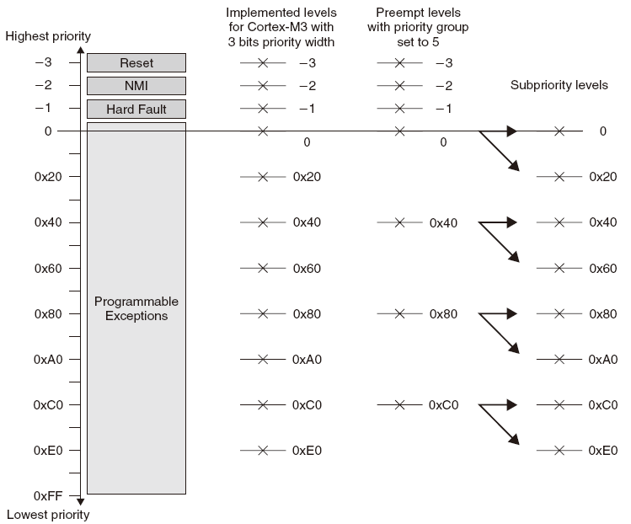


Deciding the Effective Preempt priority and Subpriority Levels

Slide 12
9.1.3 Vector Table
The processor will need to locate the starting address of the exception handler when an exception is being handled. This information is stored in the vector table.
Exception Vector Table After Power Up
Address | Exception Number | Value (Word Size)
0x00000000 | — | MSP initial value
0x00000004 | 1 | Reset vector (program counter initial value)
0x00000008 | 2 | NMI handler starting address
0x0000000C | 3 | Hard fault handler starting address
… | … | Other handler starting address

Slide 13
The vector table can be relocated to other locations in the Code or RAM region, done by setting the vector table offset register in the NVIC.
The address offset should be aligned to the vector table size which is rounded to the power of 2.
Example:
Total IRQ inputs: 32
The total number of exceptions: 32 + 16 (system exceptions) = 48
Extending it to the power of 2: 64.
Multiplying it by 4: 256.
The vector table offset can be programmed as 0x0, 0x100, 0x200, and so on.

Slide 14
9.1.4 Interrupt Inputs and Pending Behavior
When an interrupt input is asserted, it can be pended (pending status is hold by a register)
Even if the interrupt source de-asserts the interrupt, the pended interrupt status will still cause the interrupt handler to be executed.
Interrupt Pending

Slide 15
If the pending status is cleared (the pending status of the interrupt can be accessed in the NVIC and is writable) before the processor starts responding to the pended interrupt, the interrupt can be canceled.
you can clear a pending interrupt or use software to pend a new interrupt by setting the pending register
Interrupt Pending Cleared Before Processor Takes Action

Slide 16
When the processor starts to execute an interrupt, the interrupt becomes active and the pending bit will be cleared automatically.
Interrupt Active Status Set as Processor Enters Handler

Slide 17
If an interrupt source continues to hold the interrupt request signal active, the interrupt will be pended again at the end of the interrupt service routine.
Continuous Interrupt Request Pends Again After Interrupt Exit

Slide 18
If an interrupt is pulsed several times before the processor starts processing it, it will be treated as one single interrupt request.
Interrupt Pending Only Once, Even with Multiple Pulses Before the Handler

Slide 19
If an interrupt is de-asserted and then pulsed again during the interrupt service routine, it will be pended again.
Interrupt Pending Occurs Again During the Handler

Slide 20
9.1.5 Fault Exceptions
9.1.5.1 Bus faults
Bus faults are produced when an error response is received during a transfer on the AHB interfaces.
Bus fault due to:(BFSR Register records the status)
1. Prefetch abort (Instruction prefetch)
2. Data abort (data read/write)
3. Stacking error (stack PUSH in the beginning of interrupt processing)
4. Unstacking error (stack POP at the end of interrupt processing)
5. Reading of an interrupt vector address error (when the processor starts the interrupt-handling sequence)

Slide 21
When these types of bus faults take place
If
1. The bus fault handler is enabled (BUSFAULTENA bit in the System Handler Control and State register in the NVIC).
2. No other exceptions with the same or higher priority are running.
Then
The bus fault handler will be executed.
Else if
At the same time the core receives another exception handler with higher priority.
Then
The bus fault exception will be pending.
Note: if the bus fault handler is not enabled or when the bus fault happens in an exception handler that has the same or higher priority than the bus fault handler, the hard fault handler will be executed instead

Slide 22
The NVIC has a number of fault status registers. One of them is the Bus Fault Status Register (BFSR).
Bus Fault Status Register (0xE000ED29)
Bits | Name | Type | Reset Value | Description
7 | BFARVALID | — | 0 | Indicates BFAR is valid
6:5 | — | — | — | —
4 | STKERR | R/Wc | 0 | Stacking error
3 | UNSTKERR | R/Wc | 0 | Unstacking error
2 | IMPREISERR | R/Wc | 0 | Imprecise data access violation
1 | PRECISERR | R/Wc | 0 | Precise data access violation
0 | IBUSERR | R/Wc | 0 | Instruction access violation

Slide 23
9.1.5.2 Memory Management Faults
Common memory manage faults include:
1. Access to memory regions not defined in MPU setup.
2. Execute code from nonexecutable memory regions.
3. Writing to read-only regions.
4. An access in the user state to a region defined as privileged access only.

Slide 24
When a memory manage faults occurs
if
1. The memory manage fault handler is enabled (set the MEMFAULTENA bit in the System Handler Control and State register in the NVIC).
2. No other exceptions with the same or higher priority are running.
Then
The memory manage fault handler will be executed.
Else if
At the same time the core receives another exception handler with higher priority.
Then
The memory manage fault exception will be pending.
Note: If the processor is already running an exception handler with same or higher priority or if the memory management fault handler is not enabled, the hard fault handler will be executed instead.

Slide 25
The NVIC contains a Memory Management Fault Status Register (MFSR) to indicate the cause of the memory management fault.
Memory Management Fault Status Register (0xE000ED28)
Bits | Name | Type | Reset Value | Description
7 | MMARVALID | — | 0 | Indicates the MMAR is valid
6:5 | — | — | — | —
4 | MSTKERR | R/Wc | 0 | Stacking error
3 | MUNSTKERR | R/Wc | 0 | Unstacking error
2 | — | — | — | —
1 | DACCVIOL | R/Wc | 0 | Data access violation
0 | IACCVIOL | R/Wc | 0 | Instruction access violation

Slide 26
9.1.5.3 Usage Faults
Usage faults can be caused by:
1. Undefined instructions
2. Coprocessor instructions (the Cortex-M3 processor does not support a coprocessor)
3. Trying to switch to the ARM state (This can happen if you load a new value to PC with the LSB equal to 0)
4. Invalid interrupt return (Link Register contains invalid/incorrect values)
5. Unaligned memory accesses using multiple load or store instructions
It is possible, by setting up certain control bits in the NVIC, to generate usage faults for:
1. Divide by zero
2. Any unaligned memory accesses

Slide 27
When a usage fault occurs
if
1. The usage fault handler is enabled (set the USGFAULTENA bit in the System Handler Control and State register in the NVIC).
2. No other exceptions with the same or higher priority are running.
Then
The usage fault handler will be executed.
Else if
At the same time the core receives another exception handler with higher priority.
Then
The usage fault exception will be pending.
Note: If the processor is already running an exception handler with same or higher priority or if the usage fault handler is not enabled, the hard fault handler will be executed instead.

Slide 28
The NVIC provides a Usage Fault Status Register (UFSR) for the usage fault handler to determine the cause of the fault.
Usage Fault Status Register (0xE000ED2A)
Bits | Name | Type | Reset Value | Description
9 | DIVBYZERO | R/Wc | 0 | Indicates a divide by zero has taken place (can be set only if DIV_0_TRP is set)
8 | UNALIGNED | R/Wc | 0 | Indicates that an unaligned access fault has taken place
7:4 | — | — | — | —
3 | NOCP | R/Wc | 0 | Attempts to execute a coprocessor instruction
2 | INVPC | R/Wc | 0 | Attempts to do an exception with a bad value in the EXC_RETURN number
1 | INVSTATE | R/Wc | 0 | Attempts to switch to an invalid state (e.g., ARM)
0 | UNDEFINSTR | R/Wc | 0 | Attempts to execute an undefined instruction

Slide 29
9.1.5.4 Hard Faults
The hard fault handler can be caused by:
1. Usage faults, bus faults, and memory management faults if their handler cannot be executed
2. A bus fault during vector fetch
Hard Fault Status Register (0xE000ED2C)
Bits | Name | Type | Reset Value | Description
31 | DEBUGEVT | R/Wc | 0 | Indicates hard fault is triggered by debug event
30 | FORCED | R/Wc | 0 | Indicates hard fault is taken because of bus fault, memory management fault, or usage fault
29:2 | — | — | — | —
1 | VECTBL | R/Wc | 0 | Indicates hard fault is caused by failed vector fetch
0 | — | — | — | —

Slide 30
9.1.5.5 Dealing with Faults
In a real system, after the cause of a fault is determined (use the Fault Status Registers [FSRs]), the software will have to decide what to do next.
If OS exists, the OS could terminates the offending tasks;
otherwise,
1. Reset: Using the VECTRESET control bit in the Application Interrupt and Reset Control register in the NVIC (reset the processor core but not the whole chip [using the SYSRESETREQ instead]).
2. Recover: It is possible to resolve the problem that caused the fault exception.
Note: The FSRs retain their status until they are cleared manually by using a write-to-clear mechanism (clear by writing 1 to the bits that need to be cleared) in fault handlers

Slide 31
9.1.6 SVC and PendSV
SVC (System Service Call) and PendSV (Pended System Call) are two exceptions targeted at software and operating systems.
9.1.6.1 SVC
SVC is for generating system function calls.
Example:
Instead of allowing user programs to directly access hardware, operating system may provide access to hardware via an SVC.
SVC can make software more portable because the user application does not need to know the programming details of the hardware.

Slide 32
SVC as a Gateway for OS Functions
SVC is generated using the SVC instruction.
Example:
SVC 0x3 ; Call SVC function 3
With the Cortex-M3 interrupt priority model, a SVC cannot be used in a SVC (or other exceptions with higher priority, such as NMI and hard fault)

Slide 33
9.1.6.2 PendSV
PendSV (Pended System Call) works with SVC in the OS. PendSV can be pended and is useful for an OS to pend an exception so that an action can be performed after other important tasks(with higher priority) are completed.
A typical use of PendSV is context switching (switching between tasks).
Example:
A system with only two tasks, and a context switch can be triggered by SYSTICK exceptions.

Slide 34
A Simple Scenario Using SYSTICK to Switch Between Two Tasks

Slide 35
Problems at Context Switching at the IRQ
If an interrupt request takes place before the SYSTICK exception, the SYSTICK exception will preempt the IRQ handler. What’s the problem?
One solution: context switching can happen only if the OS detects that none of the IRQ handlers are being executed. When the frequency of the IRQ source is close to the SYSTICK?

Slide 36
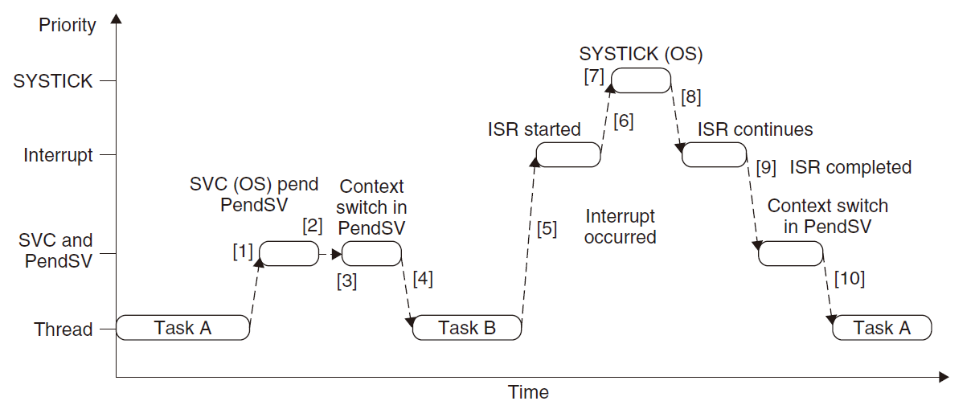
Another solution: using PendSV which is programmed at lowest priority level

Slide 37
9.2 The NVIC and Interrupt Control
9.2.1 NVIC Overview
The Nested Vectored Interrupt Controller, or NVIC, is an integrated part of the Cortex-M3 processor.
The NVIC supports 1 to 240 external interrupt inputs and a Nonmaskable Interrupt (NMI) input.
The NVIC can be accessed as memory location 0xE000E000.
Most of the interrupt control/ status registers are accessible only in privileged mode (access via MRS and MSR)
Except the Software Trigger Interrupt register, which can be set up to be accessible in user mode
The interrupt control/status register can be accessed in word, half word, or byte transfers
In addition, a few other interrupt-masking registers are also involved in the interrupts.

Slide 38
9.2.2 The Basic Interrupt Configuration
Each external interrupt has several registers associated with:
1. Enable and clear enable registers
2. Set-pending and clear-pending registers
3. Priority level
4. Active status
A number of other registers can also affect the interrupt processing:
1. Exception-masking registers
2. Vector Table Offset register
3. Software Trigger Interrupt register
4. Priority Group

Slide 39
9.2.3 Interrupt Enable and Clear Enable
The Interrupt Enable register is programmed via two addresses.
To set the enable bit, write 1 to the SETENA register address;
To clear the enable bit, write 1 to the CLRENA register address.
External interrupts: Up to 240;
So for each interrupt NVIC has a SETENA and a CLRENA register.
SETENA: 0xE000E100--0xE000E11C
CLRENA: 0xE000E180-0xE000E19C

Slide 40
Interrupt Set Enable Registers and Interrupt Clear Enable Registers
Name | Type | Address | Reset Value | Description
SETENA0 | R/W | 0xE000E100 | 0 | Enable for external interrupt #0-31
SETENA1 | R/W | 0xE000E104 | 0 | Enable for external interrupt #32-63
… | … | … | … | …
SETENA7 | R/W | 0xE000E11C | 0 | Enable for external interrupt #224-239
CLRENA0 | R/W | 0xE000E180 | 0 | Clear Enable for external interrupt #0-31
CLRENA1 | R/W | 0xE000E184 | 0 | Clear Enable for external interrupt #32-63
… | … | … | …
CLRENA7 | R/W | 0xE000E19C | 0 | Clear Enable for external interrupt #224-239

Slide 41
9.2.4 Interrupt Pending and Clear Pending
If an interrupt takes place but cannot be executed immediately, it will be pended.
The interrupt-pending status can be accessed through the Interrupt Set Pending (SETPEND) and Interrupt Clear Pending (CLRPEND) registers. User can set the certain bit of SETPEND to enter its handler by software.
Similarly to the enable registers, for each interrupt NVIC has a SETPEND and a CLRPEND register.
SETPEND: 0xE000E200-0xE000E21C
CLRPEND: 0xE000E280-0xE000E29C

Slide 42
Interrupt Set Pending Registers and Interrupt Clear Pending Registers
Name | Type | Address | Reset Value | Description
SETPEND0 | R/W | 0xE000E200 | 0 | Pending for external interrupt #0-31
SETPEND1 | R/W | 0xE000E204 | 0 | Pending for external interrupt #32-63
… | … | … | … | …
SETPEND7 | R/W | 0xE000E21C | 0 | Pending for external interrupt #224-239
CLRPEND0 | R/W | 0xE000E280 | 0 | Clear pending for external interrupt #0-31
CLRPEND1 | R/W | 0xE000E284 | 0 | Clear pending for external interrupt #32-63
… | … | … | …
CLRPEND7 | R/W | 0xE000E29C | 0 | Clear pending for external interrupt #224-239

Slide 43
9.2.4.1 Priority
Each external interrupt has an associated priority-level register (a width of 3-8 bits).
Interrupt Priority-Level Registers (0xE000E400-0xE000E4EF)
Name | Type | Address | Reset Value | Description
PRI_0 | R/W | 0xE000E400 | 0 (8-bit) | Priority-level external interrupt #0
PRI_1 | R/W | 0xE000E401 | 0 (8-bit) | Priority-level external interrupt #1
… | … | … | … | ..
PRI_239 | R/W | 0xE000E4EF | 0 (8-bit) | Priority-level external interrupt #239

Slide 44
9.2.4.2 Active Status
Each external interrupt has an active status bit.
When the processor starts the interrupt handler, the bit is set to 1 and cleared when the interrupt return is executed.
Interrupt Active Status Registers (0xE000E300-0xE000E31C)
Name | Type | Address | Reset Value | Description
ACTIVE0 | R | 0xE000E300 | 0 | Active status for external interrupt #0-31
ACTIVE1 | R | 0xE000E304 | 0 | Active status for external interrupt #32-63
… | … | … | … | …
ACTIVE7 | R | 0xE000E31C | 0 | Active status for external interrupt #224-239

Slide 45
9.2.4.3 PRIMASK and FAULTMASK Special Registers
The PRIMASK register disables all exceptions except NMI and hard fault by changing the current priority level to 0
When PRIMASK is set, if a fault takes place, the hard fault handler will be executed)
The FAULTMASK register changes the effective current priority level to 1 so that even the hard fault handler is blocked
FAULTMASK is cleared automatically upon exiting the exception handler.
They are programmable using MRS and MSR instructions.
Example:
MOV R0, #1
MSR PRIMASK, R0 ; Write 1 to PRIMASK to disable all interrupts
MOV R0, #0
MSR PRIMASK, R0 ; Write 0 to PRIMASK to allow interrupts

Slide 46
9.2.4.4 The BASEPRI Special Register
The BASEPRI register disables interrupts with priority lower than a certain level.
Example:
MOV R0, #0x60
MSR BASEPRI, R0 ; Disable interrupts with priority 0x60-0xFF
To turn off the masking:
MOV R0, #0x0
MSR BASEPRI, R0 ; Turn off BASEPRI masking
The BASEPRI register can also be accessed using the BASEPRI_MAX register name.

Slide 47
Using BASEPRI_MAX as a register, it can only be changed to a higher priority level.
Example:
MOV R0, #0x60
MSR BASEPRI_MAX, R0 ; Disable interrupts with priority 0x60, 0x61,..., etc
MOV R0, #0xF0
MSR BASEPRI_MAX, R0 ; This write will be ignored because
; it is lower level than 0x60
MOV R0, #0x40
MSR BASEPRI_MAX, R0 ; This write is allowed and change the masking
; level to 0x40
To change to a lower masking level or disable the masking, the BASEPRI register name should be used

Slide 48
9.2.4.5 Configuration Registers for Other Exceptions
Usage faults, memory management faults, and bus fault exceptions are enabled by the System Handler Control and State Register.
The System Handler Control and State Register (0xE000ED24)
Bits | Name | Type | Reset Value | Description
18 | USGFAULTENA | R/W | 0 | Usage fault handler enable
17 | BUSFAULTENA | R/W | 0 | Bus fault handler enable
16 | MEMFAULTENA | R/W | 0 | Memory management fault enable
15 | SVCALLPENDED | R/W | 0 | SVC pended; SVCall was started but was replaced by a higher-priority exception
14 | BUSFAULTPENDED | R/W | 0 | Bus fault pended; bus fault handler was started but was replaced by a higher-priority exception

Slide 49
(Continued)
13 | MEMFAULTPENDED | R/W | 0 | Memory management fault pended; memory management fault started but was replaced by a higher-priority exception
12 | USGFAULTPENDED | R/W | 0 | Usage fault pended; usage fault started but was replaced by a higher-priority exception
11 | SYSTICKACT | R/W | 0 | Read as 1 if SYSTICK exception is active
10 | PENDSVACT | R/W | 0 | Read as 1 if PendSV exception is active
8 | MONITORACT | R/W | 0 | Read as 1 if debug monitor exception is active
7 | SVCALLACT | R/W | 0 | Read as 1 if SVCall exception is active
3 | USGFAULTACT | R/W | 0 | Read as 1 if usage fault exception is active
1 | BUSFAULTACT | R/W | 0 | Read as 1 if bus fault exception is active
0 | MEMFAULTACT | R/W | 0 | Read as 1 if memory management fault exception is active

Slide 50
Interrupt Control and State Register (0xE000ED04)
Bits | Name | Type | Reset Value | Description
31 | NMIPENDSET | R/W | 0 | NMI pended(set to 1 to enter NMI by software)
28 | PENDSVSET | R/W | 0 | Write 1 to pend system call; Read value indicates pending status
27 | PENDSVCLR | W | 0 | Write 1 to clear PendSV pending status
26 | PENDSTSET | R/W | 0 | Write 1 to pend SYSTICK exception; Read value indicates pending status
25 | PENDSTCLR | W | 0 | Write 1 to clear SYSTICK pending status
23 | ISRPREEMPT | R | 0 | Indicates that a pending interrupt is going to be active in the next step (for debug)
22 | ISRPENDING | R | 0 | External interrupt pending
21:12 | VECTPENDING | R | 0 | Pending ISR number
11 | RETTOBASE | R | 0 | Set to 1 when the running exception handler will return to the base level when no other exceptions are pended
9:0 | VECTACTIVE | R | 0 | Current running interrupt service routine

Slide 51
9.2.5 Example Procedures in Setting Up an Interrupt
1. Set up the priority group register (group 0 by default).
2. Setup the hard fault and NMI handlers to a new vector table location if vector table relocation is required.
3. Set up the Vector Table Offset register if needed.
4. Set up the interrupt vector for the interrupt：[read the Vector Table Offset register and] calculate the correct memory location for the interrupt handler.
5. Set up the priority level for the interrupt.
6. Enable the interrupt.
Example in assembly:
LDR R0, =0xE000ED0C ; Application Interrupt and Reset Control Register ; ( see Table 7.5)
LDR R1, =0x05FA0500 ; Priority Group 5 (2/6)
STR R1, [R0] ; Set Priority Group

Slide 52
...
MOV R4, #8 ; Vector Table in ROM
LDR R5, =(NEW_VECT_TABLE+8)
LDMIA R4!, {R0-R1} ; Read vectors address for NMI and Hard Fault
STMIA R5!, {R0-R1} ; Copy vectors to new vector table
...
LDR R0, =0xE000ED08 ; Vector Table Offset Register
LDR R1, =NEW_VECT_TABLE
STR R1, [R0] ; Set vector table to new location
...
LDR R0, =IRQ7_Handler ; Get starting address of IRQ#7 handler
LDR R1, =0xE000ED08 ; Vector Table Offset Register
LDR R1, [R1]
ADD R1, R1, #(4*(7+16)) ; Calculate IRQ#7 handler vector address
STR R0, [R1] ; Setup vector for IRQ#7
...
LDR R0, =0xE000E400 ; External IRQ priority base

Slide 53
MOV R1, #0xC0
STRB R1, [R0,#7] ; Set IRQ#7 priority to 0xC0
...
LDR R0, =0xE000E100 ; SETEN register
MOV R1, #(1<<7) ; IRQ#7 enable bit (value 0x1 shifted by 7 bits)
STR R1, [R0] ; Enable the interrupt
Interrupt Controller Type Register gives the number of interrupt inputs supported, in granularities of 32.
Interrupt Controller Type Register (0xE000E004)
Bits | Name | Type | Reset Value | Description
4:0 | INTLINESNUM | R | – | Number of interrupt inputs in step of 32 0 = 1 to 32 1 = 33 to 64 …

Slide 54
9.2.6 Software Interrupts
Software interrupts can be generated by using:
1. The SETPEND register
2. The Software Trigger Interrupt Register (STIR)
Software Trigger Interrupt Register (0xE000EF00)
Bits | Name | Type | Reset Value | Description
8:0 | INTID | W | – | Writing the interrupt number sets the pending bit of the interrupt; for example, write 0 to pend external interrupt #0
System exceptions (NMI, faults, PendSV, and so on) cannot be pended using STIR.
STIR can be accessed in user level when the bit 1 (USERSETMPEND) of the NVIC Configuration Control Register is set.

Slide 55
9.2.7 The SYSTICK Timer
The SYSTICK Timer is integrated with the NVIC and can be used to generate a SYSTICK exception.
e.g., to allow multiple tasks to run at different time slots
All Cortex-M3 chips have the same 24-bit down counter using an internal or external clock.
The SYSTICK Timer is controlled by four registers.
Table 8.9 SYSTICK Control and Status Register (0xE000E010)
Bits | Name | Type | Reset Value | Description
16 | COUNTFLAG | R | 0 | Read as 1 if counter reaches 0 since last time this register is read. Read clears this bit.
2 | CLKSOURCE | R/W | 0 | 0 = External reference clock (STCLK) 1 = Use core clock
1 | TICKINT | R/W | 0 | 1 = Enable SYSTICK interrupt generation when SYSTICK timer reaches 0 0 = Do not generate interrupt
0 | ENABLE | R/W | 0 | SYSTICK timer enable

Slide 56
SYSTICK Reload Value Register (0xE000E014)
Bits | Name | Type | Reset Value | Description
23:0 | RELOAD | R/W | 0 | Reload value when timer reaches 0
SYSTICK Current Value Register (0xE000E018)
Bits | Name | Type | Reset Value | Description
23:0 | CURRENT | R/Wc | 0 | Read to return current value of the timer. Write to clear counter to 0. Clearing of current value also clears COUNTFLAG in SYSTICK Control and Status Register

Slide 57
SYSTICK Calibration Value Register (0xE000E01C)
Bits | Name | Type | Reset Value | Description
31 | NOREF | R | – | 1 = No external reference clock (STCLK not available) 0 = External reference clock available
30 | SKEW | R | – | 1 = Calibration value is not exactly 10 ms 0 = Calibration value is 10ms
23:0 | TENMS | R/W | 0 | Calibration value for 10 ms.; chip designer should provide this value via Cortex-M3 input signals. If this value is read as 0, calibration value is not available
The SYSTICK Timer can also be used for:
1. as an alarm timer
2. for timing measurement

Slide 58
9.3 Interrupt Behavior
9.3.1 Interrupt/Exception Sequences
When an exception takes place, a number of things happen:
Stacking (pushing eight registers’ contents to stack)
Vector fetch (reading the exception handler starting address from the vector table)
Update of the stack pointer, link register, and program counter

Slide 59
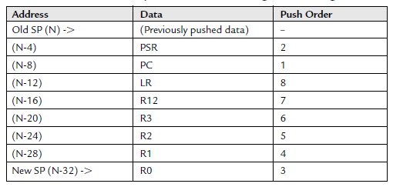
9.3.1.1 Stacking
When an exception takes place, the registers PC, PSR, R0–R3, R12, and LR are pushed to the stack
If the code that is running uses the PSP, the process stack will be used; if the code that is running uses the MSP, the main stack will be used
The main stack will always be used during the handler

Slide 60
9.3.1.2 Vector Fetches
While the data bus is busy stacking the registers, the instruction bus fetches the exception vector (the starting address of the exception handler) from the vector table.
Since the stacking and vector fetch are performed on separate bus interfaces, they can be carried out at the same time

Slide 61
9.3.1.3 Register Updates
After the stacking and vector fetch are completed, the exception vector will start to execute.
On entry of the exception handler, a number of registers will be updated:
SP: The Stack Pointer (either the MSP or the PSP)
PSR: The IPSR (the lowest part of the PSR) will be updated to the new exception number
PC: This will change to the vector handler as the vector fetch completes
LR: The LR will be updated to a special value called EXC_RETURN, used to store the states of the interrupted program (i.e., which stack used, instruction state, thread/handler mode)

Slide 62
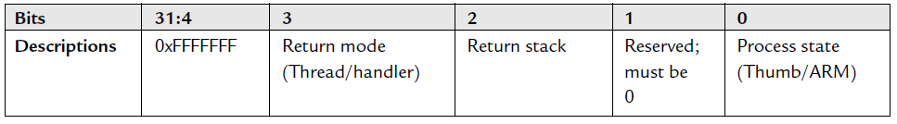
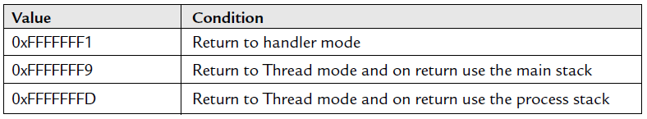
When entering an exception handler, the LR is updated to a special value called EXC_RETURN (updated automatically).

Slide 63
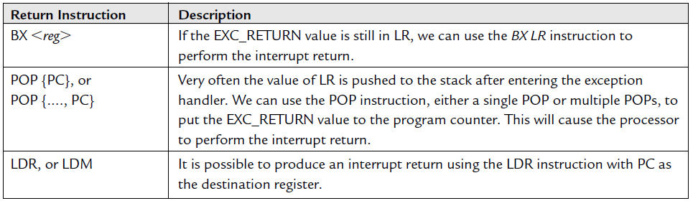
9.3.1.3 Exception Exits
At the end of the exception handler, an exception exit is required to restore the system status so that the interrupted program can resume normal execution.
When the EXC_RETURN is loaded into the PC at the end of the exception handler execution, the processor performs an exception return sequence
There are three ways to trigger the interrupt return sequence:

Slide 64
When the interrupt return instruction is executed, the following processes are carried out:
Un-stacking: The registers pushed to the stack will be restored
NVIC register update: The active bit of the exception will be cleared. For external interrupts, if the interrupt input is still asserted, the pending bit will be set again, causing it to reenter the interrupt handler

Slide 65
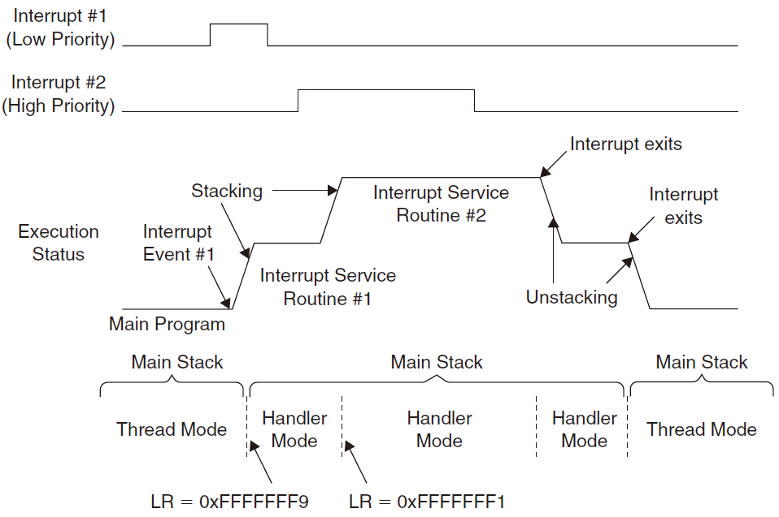
LR set to EXC_RETURN at exception example:

Slide 66
9.3.2 Nested Interrupts
Being built into the Cortex-M3 processor core and the NVIC :
When the processor is handling an exception, all other exceptions with the same or lower priority will be blocked (pended)
The automatic hardware stacking and un-stacking allow the nested interrupt handler to execute without risk of losing data in registers
Be Aware of:
Make sure that there is enough space in the main stack if lots of nested interrupts are allowed
Reentrant exceptions are not allowed in the Cortex-M3, SVC instructions cannot be used inside an SVC handler

Slide 67
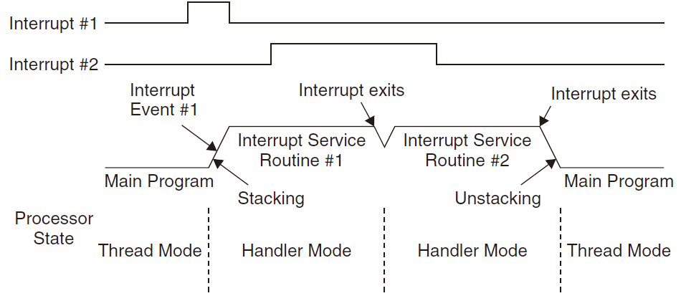
9.3.3 Tail-Chaining Interrupts
Used to improve interrupt latency:
When the processor is handling an exception, all other exceptions with the same or lower priority will be blocked (pended)
When the processor has finished executing the current exception handler, the un-stacking for this handler and the stacking for the next handler are skipped

Slide 68
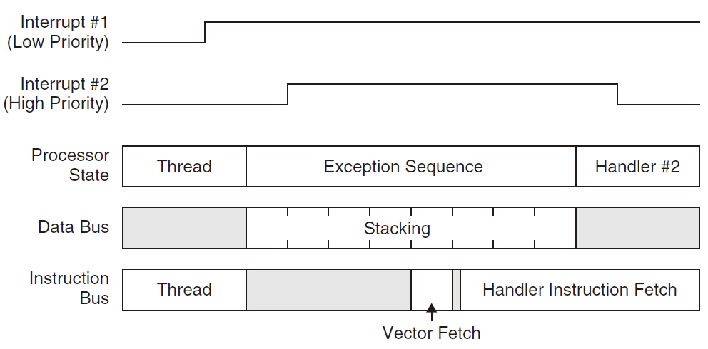
9.3.4 Late Arrival Exception Handling
Used to improve interrupt latency:
When an exception takes place and the processor has started the stacking process, if a new exception arrives with higher preemption priority, the late arrival exception will be processed first.

Slide 69
9.3.5 Faults Related to Interrupts
Stacking faults: a bus fault exception will be triggered or pended
Un-stacking faults: a bus fault exception will be triggered or pended
Vector fetch faults: the hard fault handler will be executed
Invalid return faults: If the EXC_RETURN number is invalid or does not match the state of the processor, the usage fault handler will be triggered or pended

